Slide 1
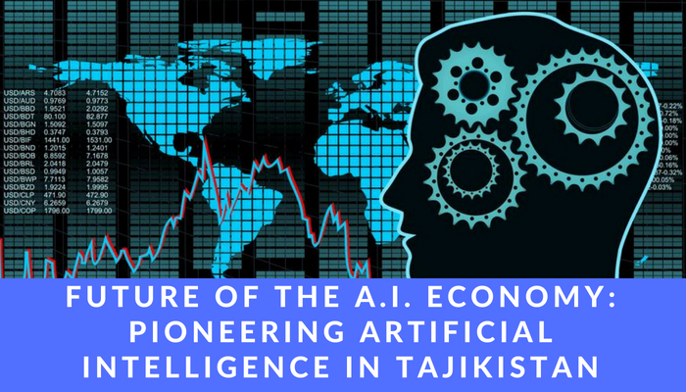
Team:
Innovation Incubator
Cohort II Presentation
25 May 2018
Maqsudjon Qalandarov
Khujand State University – Faculty of Foreign Languages
Khosiyat Oripova
Polytechnic Lyceum in Khujand
Abbosjon Madiev
School #5 of Jabbor Rasulov district
Dildora Hikmatulloeva
Lyceum for Gifted Students in Khujand

Slide 2
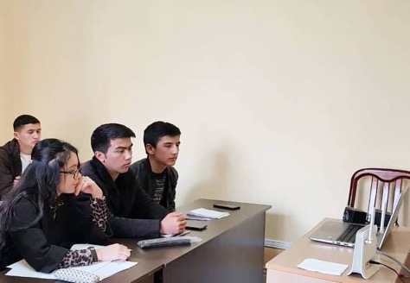
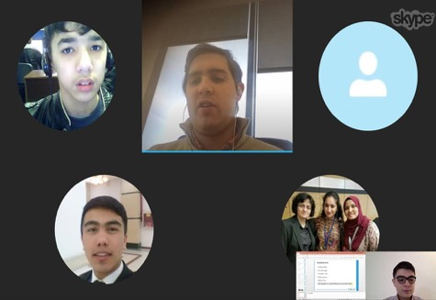
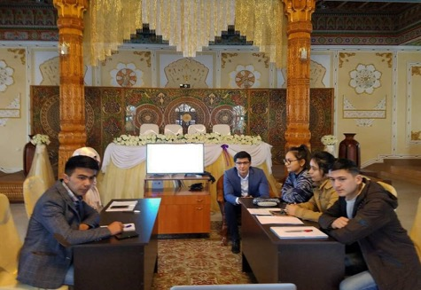
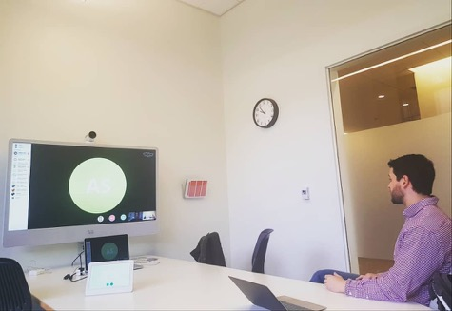
Innovation Incubator: Cohort II (February – May 2018)
Topics:
-Supply & demand analysis
-Consumer & producer theory
-Comparative advantage & international trade
-Startup entrepreneurship & capital markets
-Digitalization & artificial intelligence

Slide 4
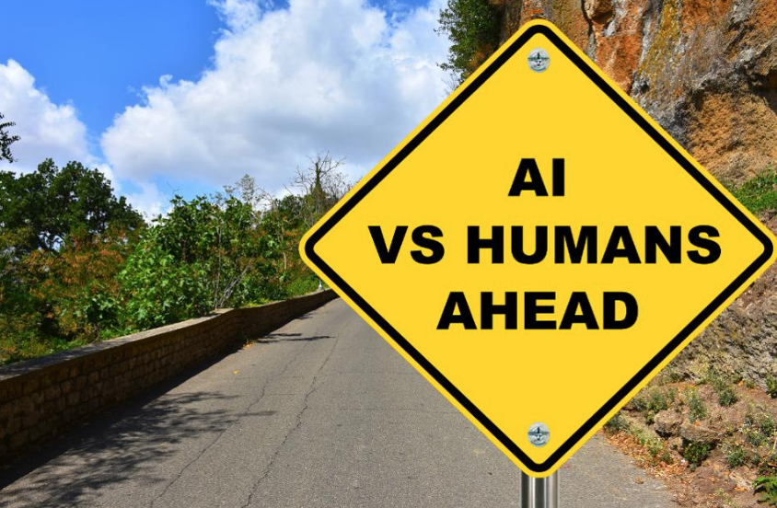

Slide 5
Stanford Professor John McCarthy coined the term “Artificial Intelligence” in 1955
He defined intelligence as “computational part of the ability to achieve goals in the world”
AI involves development of computer systems that are able to perform tasks requiring human intelligence
As a term, AI is also used interchangeably with automation and machine learning

Slide 6
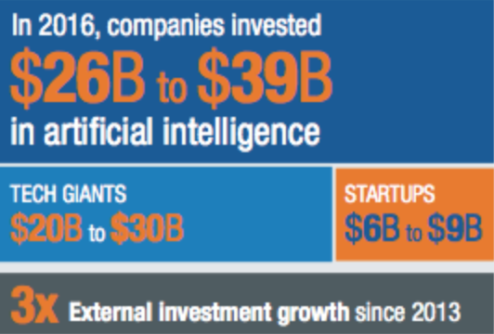
McKinsey estimated that in 2016 alone, $26 to $39 billion was invested in AI globally.
The use of AI has encompassed a variety of fields – from medicine to law enforcement.

Slide 8
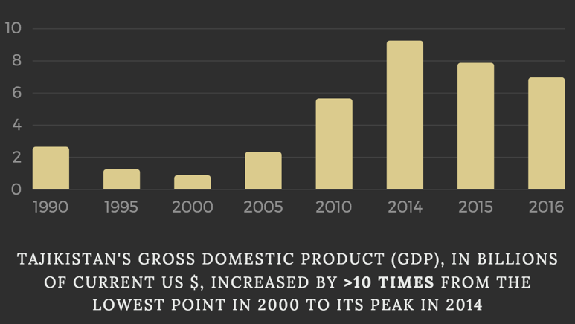
Overview of Tajikistan’s Economy:
Expansion since the civil war of the 1990s
Peak GDP of over $9 billion in 2014
Over-reliance on migrant remittances and export of raw materials

Slide 11
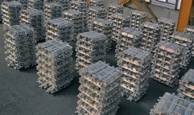
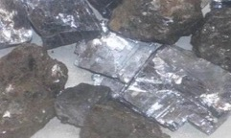
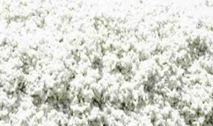
Main Exports:
$2 billion
was the trade deficit of Tajikistan in 2016.
Aluminum
Ore
Gold
Cotton

Slide 12
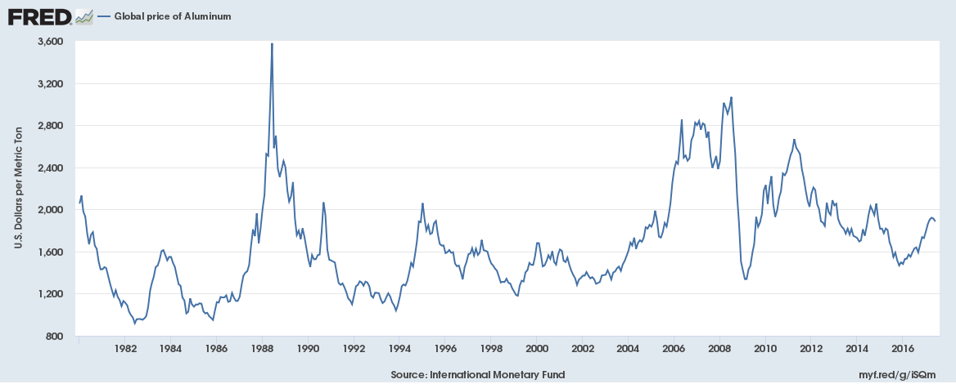
Tajikistan’s export orientation on raw materials is volatile given fluctuation in global commodity prices

Slide 14
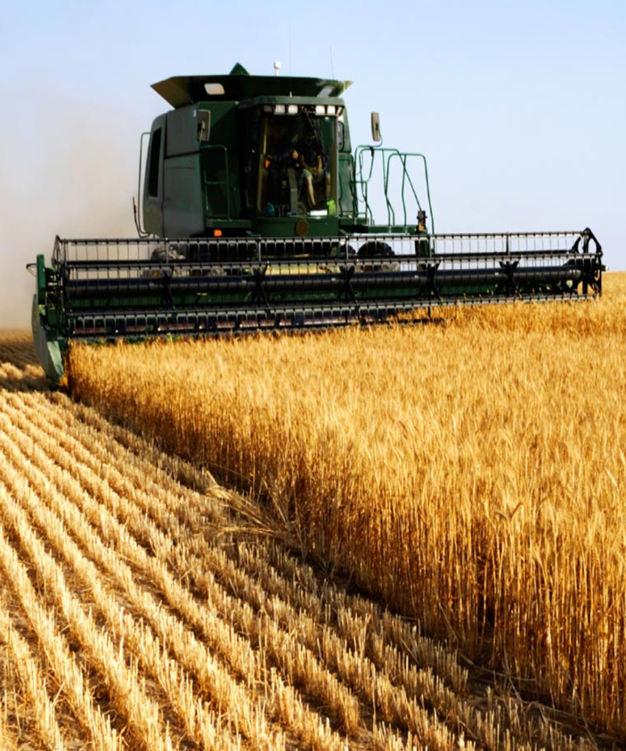
Increased need for productivity in agriculture:
Population growth (Tajikistan has a high fertility rate of 3.5 births per woman)
Climate change (water shortages and droughts)

Slide 15
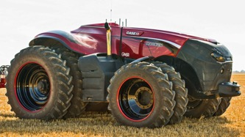
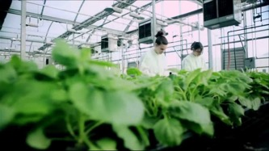
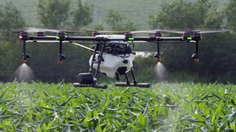
Impact of AI on agriculture:
Automation (ex: self-driving tractors)
Technological product innovation (ex: bioengineering of seeds)
Data analytics (ex: targeted farming and yield analysis)

Slide 16
Increasing supply chain efficiency:
Intermediaries in the local market accrue too much of the value
Enhancing access of farmers to virtual marketplaces would facilitate trade
Example: onion cultivation in Jabbor Rasulov district

Slide 17
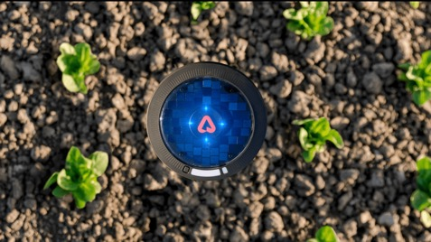
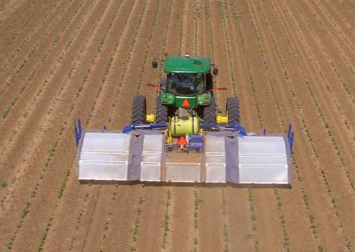
AI innovation in agriculture:
Pulsepod sensor by Arable Labs (solar-powered, in-ground sensor)
See & Spray robot by Blue River Technology (monitoring and spraying)

Slide 18
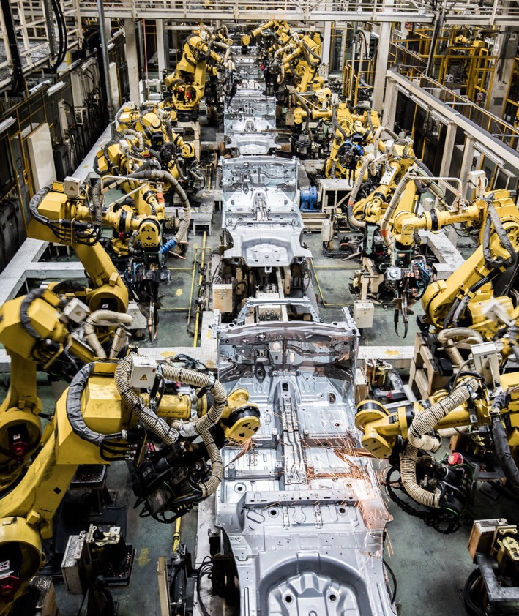
Limited impact of AI on Tajikistan’s industrial sector:
Use of automation already in place in the primary sector (i.e. raw materials)
Lack of manufacturing base

Slide 19
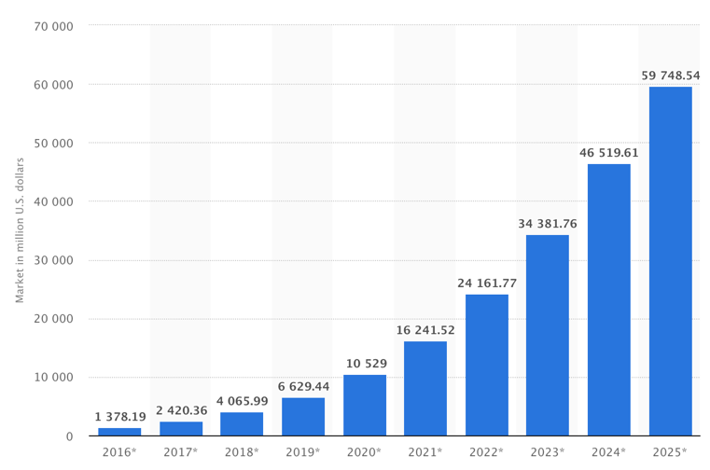
Future AI Outlook:
Expected growth of global AI market size to nearly $60 billion by 2025
CAGR of >50%
While advanced economies are in the lead, the field is still wide open for developing countries

Slide 20
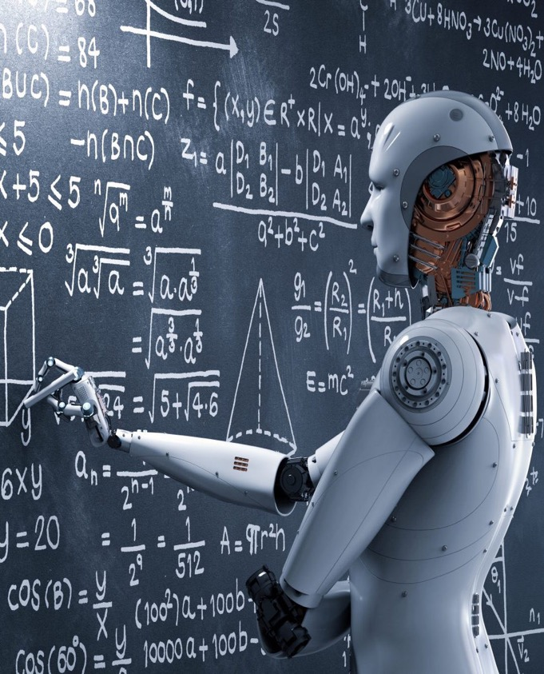
AI as an industrial opportunity for Tajikistan:
Talent base: strong engineering and technical skills among students
Location: opportunity for regional competitive advantage

Slide 21
Recommendation:
Leverage talent base and strategic location to attract foreign direct investment (FDI) and pioneer AI as a long-term industry of the future
Focus on public-private partnerships to ensure concurrent development of education and industry
Model: Google and Facebook AI labs and research centers worldwide

Slide 22
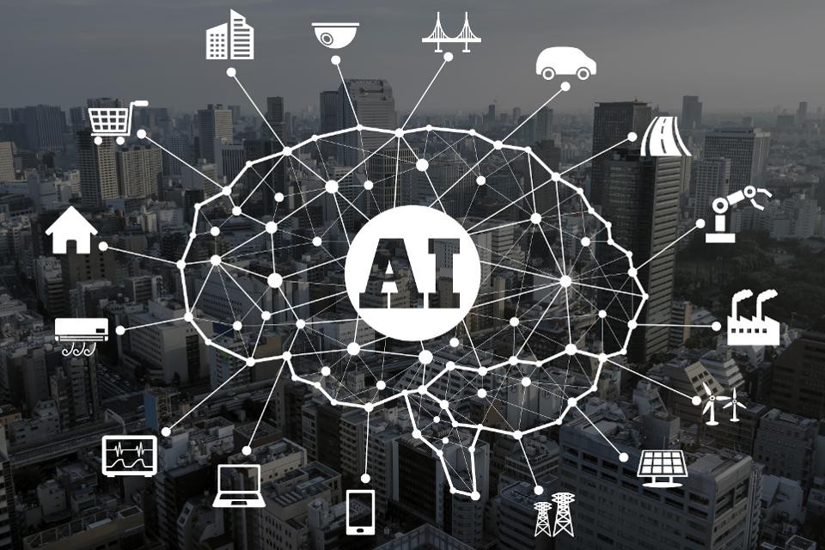
Tremendous potential for AI in services sector:
Growing share of services as % of GDP and as % of labor force employment in Tajikistan
Lack of innovation in services

Slide 23
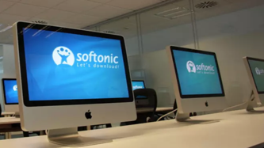
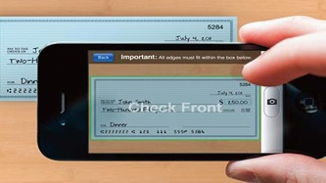
AI innovation in services:
Chatbots processing reservations (retail and tourism)
Robo-readers grading student essays (education)
Mobile check deposits & robo-advisors (banking and finance)

Slide 24
Key Takeaways:
Tajikistan’s current economic structure is unsustainable
Pioneering artificial intelligence industry can bring us a leap forward into the tech economy of the future
Implementing free market policies will incentivize FDI and domestic entrepreneurship in AI

Slide 25
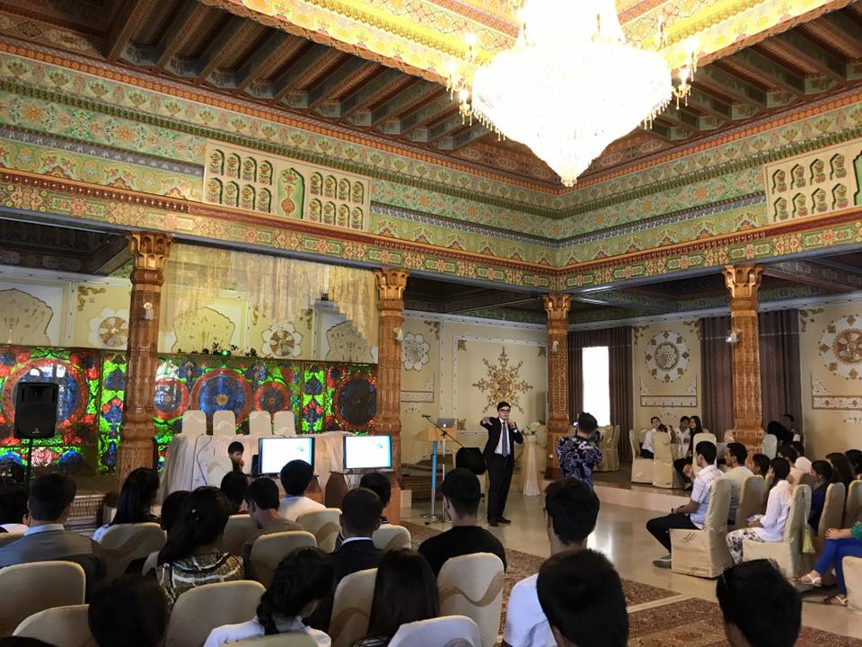
Thank You!
Questions?

