Slide 2
Project Team
Project Lead: Azizjon Azimi (Harvard University)
Team Members:
Ganjina Oripova (New York University Abu Dhabi)
Baroat Mirsadikova (Moscow State Institute of International Relations)
Aziza Yuldasheva (KIMEP University)
Malika Musaeva (Tajik State University of Commerce)
Aminjon Tursunov (Khujand Branch of Technological University of Tajikistan)

Slide 3
Our Approach
Structured as a consulting project
Data analytics combined with interviews and best practices research
Macro-overview of the higher education system

Slide 4
Agenda
Admissions Process Reform
Bologna Process Implementation
Academic Standardization
Infrastructure & Technology
Tackling Corruption
Funding

Slide 5
Admissions Process

Slide 6
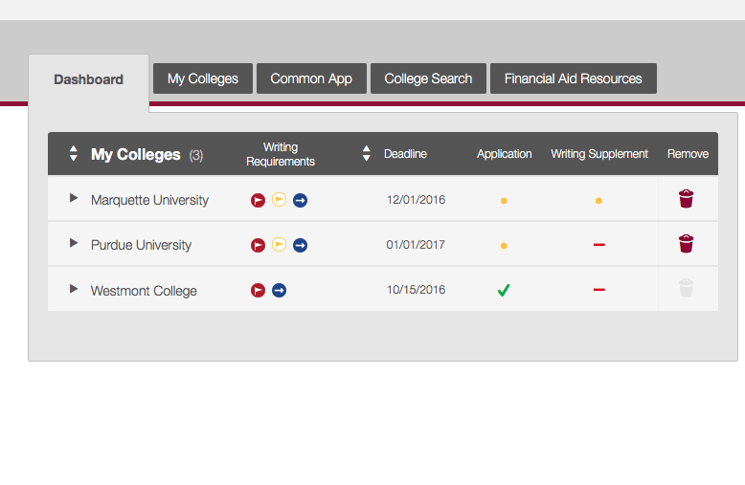
Problem Identification
Overview: annual standardized test as the only criteria for admission
Overlooks important elements including financial background, leadership capability and future plans while limiting timeline flexibility
Best practices:
CommonApp in the US
UCAS in the UK

Slide 7
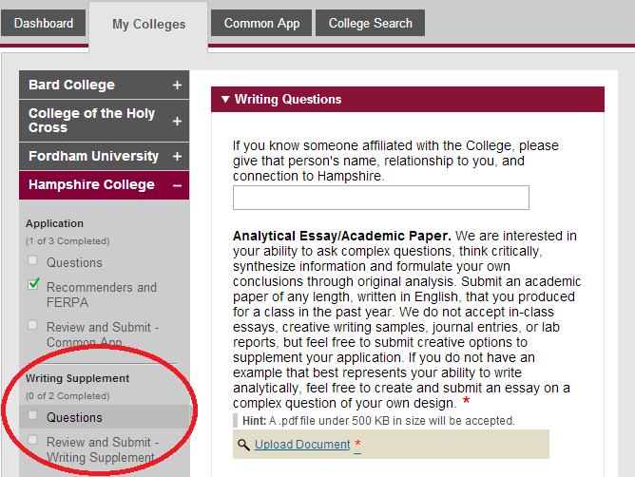
Solution: Admissions Criteria Diversification
Create a centralized, virtual application database for all state-run universities
Complement existing infrastructure of www.ntc.tj)
Enable university- and major-specific questions
Incorporate the following components:
Family & financial background
Personal statement/essay
Academics (school grades)
Extracurricular activities
Recommendation letters
Install a tiered application timeline
Early & regular decision rounds
Increase the number of dates for the National Test to four per year

Slide 8
Bologna Process Implementation

Slide 9
Status Quo
Current number of universities: 35
130 specialties
Total rate of tertiary enrollment: 26,4%
Rate of employment with a university degree: 81%

Slide 10
Problem Identification
Inequality
Geographical Location
Gender
Regions | Population | Universities
Dushanbe, DRS | 32,5% | 22
Other regions | 67,5% | 13
 | Rate of enrollment
Male | 31%
Female | 16%
Socio-economic status

Slide 11
Bologna Process: Integration of Tajikistan
Signed between 29 European countries in 1999
50 countries have integrated into the Process since
Aim:
Harmonization of high-standard and qualified higher education;
Mobility: move/work within Europe;
Tajikistan:
Introduction of ECTS way of integration into the process

Slide 12
Pioneering Extracurricular Activities
Community service
Self-development & leadership growth
Co-curricular learning

Slide 13
Standardization

Slide 14
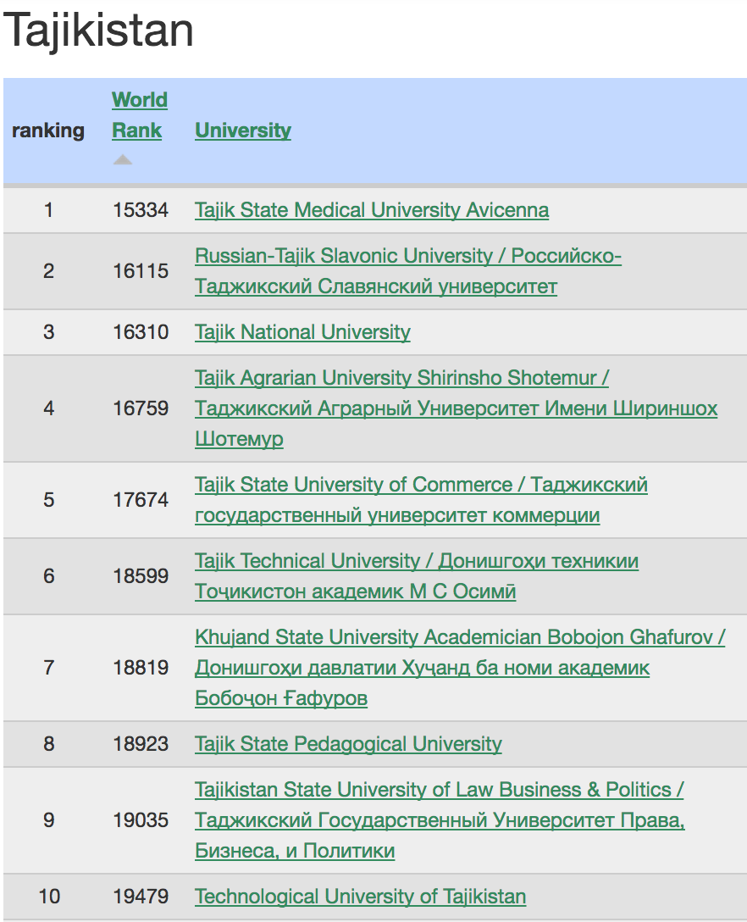
Problem Identification
Highest ranked Tajikistani university (State Medical University) is ranked 15334th in the world
Divergence in grading standards between universities in Tajikistan and abroad
Need to boost competitiveness

Slide 15
Introducing Grade Point Average (GPA)
+ Master’s abroad
+ Exchange programs
+ Plan ahead
+ Motivation
Time (implementation)

Slide 16
Weighted System Vis-à-Vis Abroad
Foreign Universities (based on interviews) | Sample Syllabus in Tajikistan (based on interviews)
Homework 10% | Homework 5%
Attendance 5% | Attendance 25%
Project 15% | Project 10%
Midterm 1 20% | Midterm 1 20%
Midterm 2 20% | Midterm 2 20%
Final Exam 30% | Final Exam 20%

Slide 17
Core, Majors & Minors
Already in place: required and elective courses
Scope of core courses needs to be diversified
Social sciences (economics, political science, etc.)
Physical sciences (physics, chemistry, biology, etc.)
Humanities (literature, linguistics, etc.)
Arts (art history, design, etc.)
Culture & philosophy
Introducing minor in addition to major
Employability boost

Slide 18
Infrastructure & Tech

Slide 19
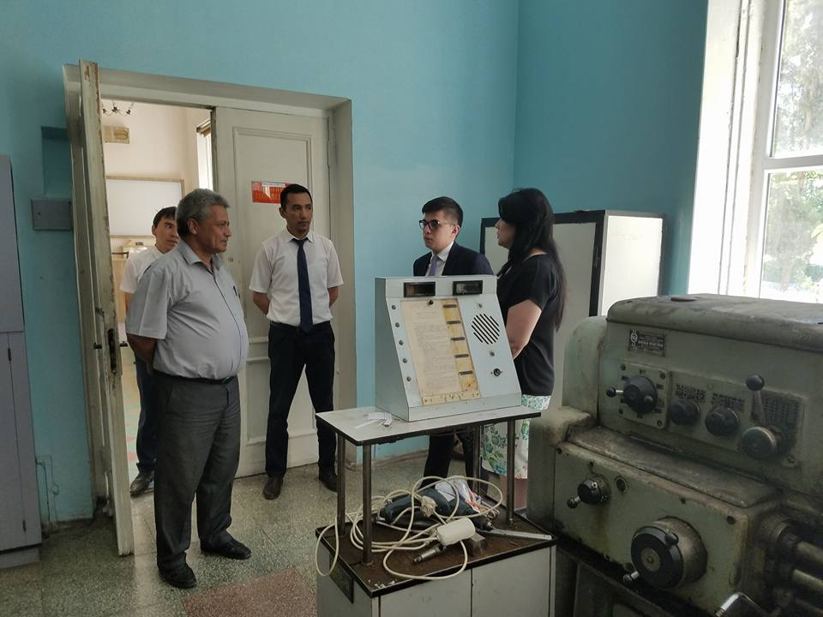
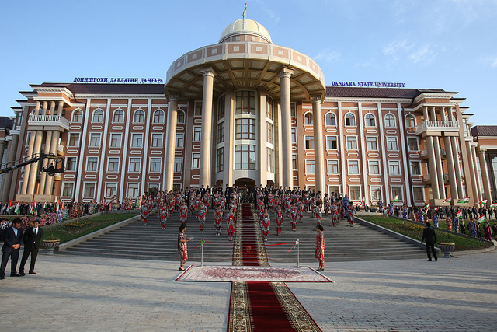
Problem Identification
Local universities have outdated infrastructural & technological bases remaining from the Soviet times (ex: Mining Metallurgical Institute of Tajikistan)
Deficiency of hi-tech science labs, art studios, student lounges
Incremental modernization
Ex: Dangara State University (state of the art capacity)

Slide 20
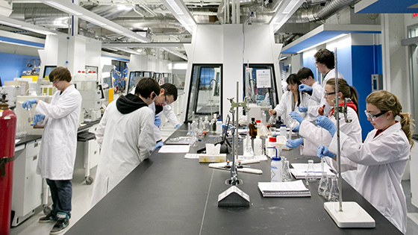
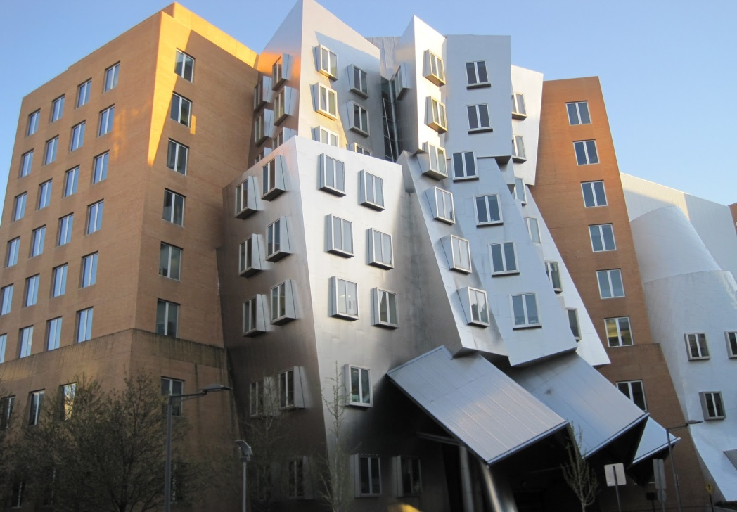
Modernization
Significant investments are required to modernize infrastructure & technology
Focus on R&D (research & development)
Best practices: MIT, CalTech

Slide 22
Problem Identification
Tajikistan ranked as 151st out of 176 countries on Transparency International’s Corruption Perception Index of public sector, including education
Causes of corruption:
Low staff wages
Lack of adequate student preparation

Slide 23
Analysis: Corruption Survey
Online survey of 38 university students encompassing Dushanbe & DRS, Sughd, Khatlon
Sample: 38 respondents (undergraduate & graduate)
Staggering level & frequency of corruption

Slide 24
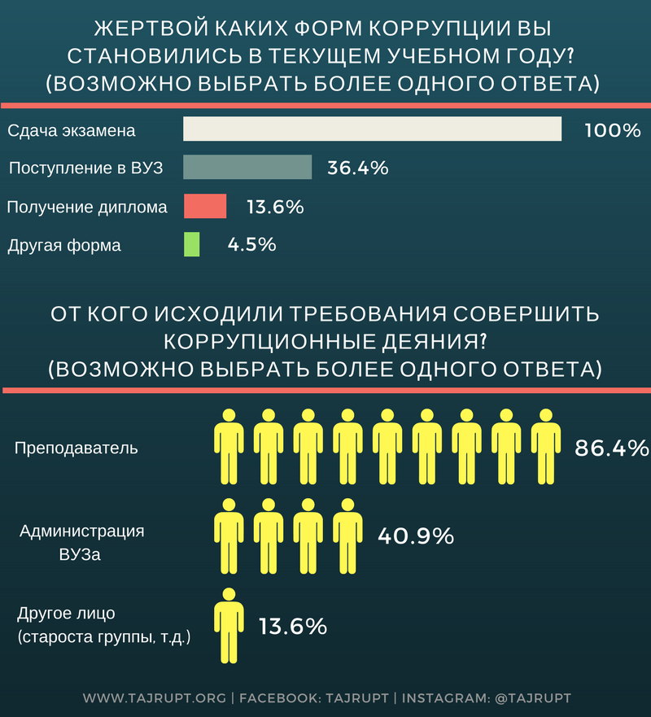
Analysis: Corruption Survey (cont.)
Most prevalent forms of corruption:
Exams
Admissions
Diploma
Most frequent bribe-seekers:
Teaching staff
Administration

Slide 25
Existential Question: How Will These Reforms Be Funded?

Slide 26
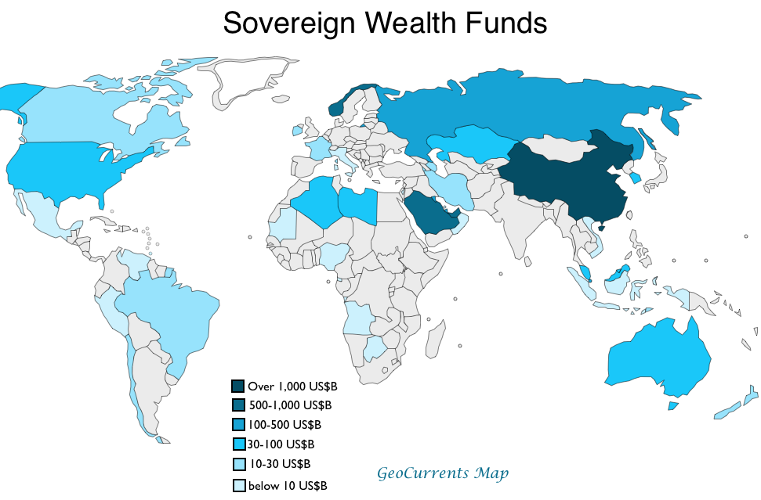
Sovereign Wealth Fund (SWF)
Systemic reforms need new & sustainable funding sources
SWF: state-owned investment fund seeking return on surplus or foreign-exchange reserves
Returns used for domestic funding (budgetary shortfalls, infrastructural projects, etc.)

Slide 27
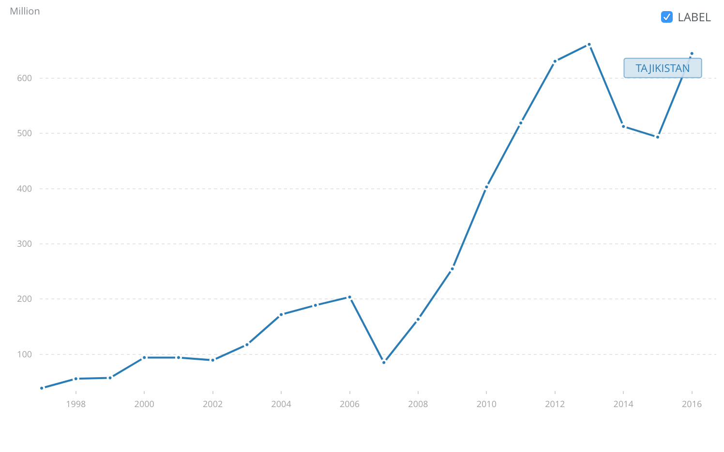
Case of Tajikistan
Tajikistan currently has $645 million in reserves (including gold)

Slide 28
Investment Proposition
Allocate a fixed percentage of total reserves to create a SWF
Use returns to fund structural reforms – including in education
Scenario: Tajikistan establishes a $50 million SWF at the end of 2010 (equivalent to 12.5% allocation from its total reserves)
Tajikistani SWF invests in generic US stocks (return measured by S&P 500 average for 2011-2016)
Year: | S&P 500 Average Market Return: | SWF Assets (year-to-year):
2016 | 11.96% | $101.18 million
2015 | 1.38% | $90.37 million
2014 | 13.69% | $89.14 million
2013 | 32.39% | $78.41 million
2012 | 16% | $59.22 million
2011 | 2.11% | $51.05 million

Slide 29
Conclusion
Need for structural reform of higher education system in Tajikistan
Complete overhaul of admissions process & philosophy
Implementation of Bologna process to boost competitiveness
Harmonization of academic standards with international practices
Tackling corruption through wage increases and administrative staff reorganization

